Slide 1
Yum! Yum! Can I have some?

Slide 2
Pat-a-Cake, Pat-a-Cake!
On last week, we focused on the child’s hand-eye coordination skills. What happened when you played the hand game?

Slide 3
Say, AWWWW!!!
Infants: experiment with the child by giving them milk or juice. Look at the child’s reactions as they drink the milk or juice. Look to see if they tighten up their face. This allows you to know if the food is salty or bitter. If their face is relaxed, this allows you to know that they like the taste.
Toddlers: Ask the child, “What do we use to taste our food?”
This Photo by Unknown Author is licensed under CC BY

Slide 4
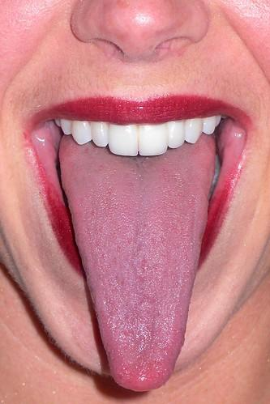
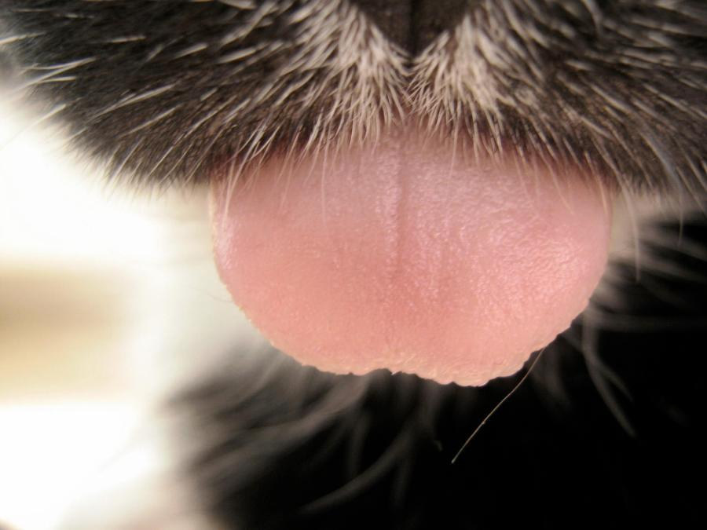
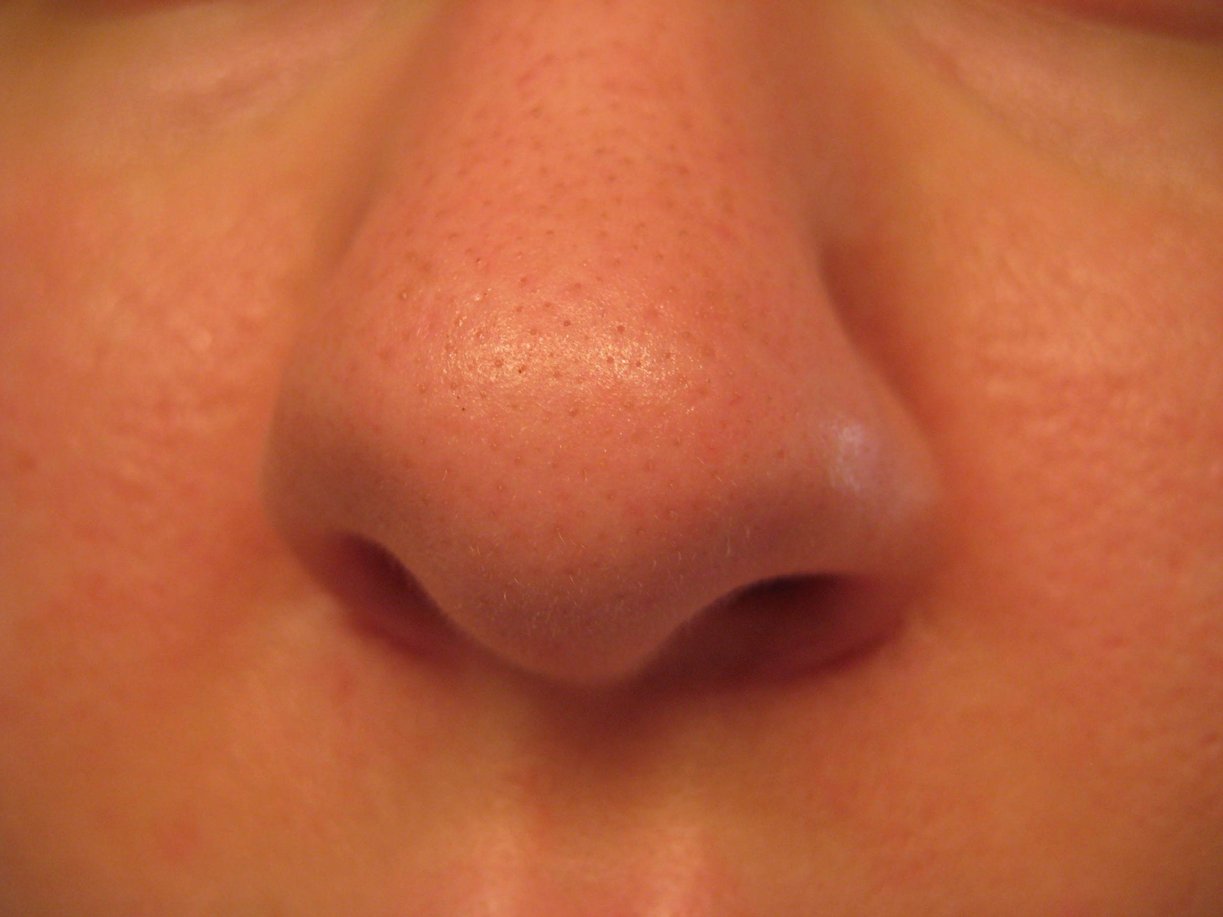
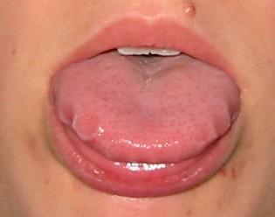
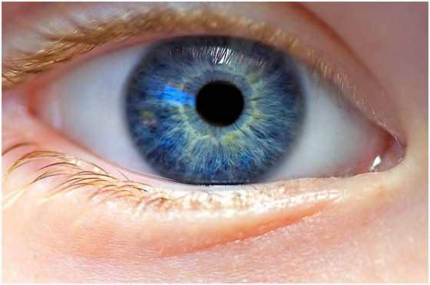
Can you pick out the tongues or the mouths?

Slide 5
I Can Taste
https://www.youtube.com/watch?v=ccD5JUyBP-8

Slide 6
JAZZ Fly 3
https://www.youtube.com/watch?v=TCzgm1HBV-c

Slide 7
Family Activities

Slide 8
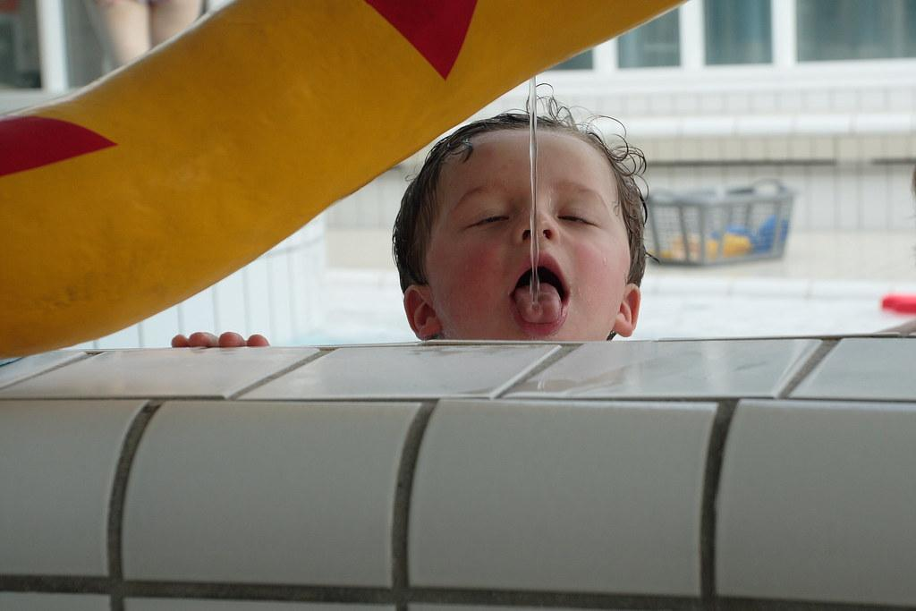
Taste Test
If your child is eating all kinds of foods, and has no allergies, help them learn about the different types of flavors and textures. For older children, have them close their eyes and see if they can guess what they are eating—and learn about the important role of vision in tasting! Foods to taste:
Salty: potato chips or french fries
Sweet: fruit juice
Sour: pickle
Bland: water
Tangy: barbecue sauce
Smooth: yogurt
Crunchy: carrots
Lumpy: Cottage Cheese
Bitter: unsweetened chocolate

Slide 9
Milestones Chart Where is your child?

Slide 10
Milestones on Taste
https://www.youtube.com/watch?v=ep5QpLQR7sY

Slide 11
Let’s Make Baby Food
https://www.youtube.com/watch?v=6A7qRfJH6oo

Slide 12
Is your child a, “Picky Eater?”

Slide 13
If so, here are some ideas.
https://www.youtube.com/watch?v=9pb7jMo5U_c
This Photo by Unknown Author is licensed under CC BY-SA

Slide 14
Additional Resources
https://www.youtube.com/watch?v=75NQK-Sm1YY
The Very Hungry Caterpillar
https://www.youtube.com/watch?v=B32u4qrIVZQ
Green Eggs and Ham

Slide 15
References
https://www.scholastic.com/parents/kids-activities-and-printables/activities-for-kids/activities-explore-taste-0-2-year-olds.html
https://www.youtube.com/watch?v=9pb7jMo5U_c
https://www.youtube.com/watch?v=6A7qRfJH6oo
https://www.youtube.com/watch?v=ep5QpLQR7sY
https://www.youtube.com/watch?v=TCzgm1HBV-c

